Slide 1
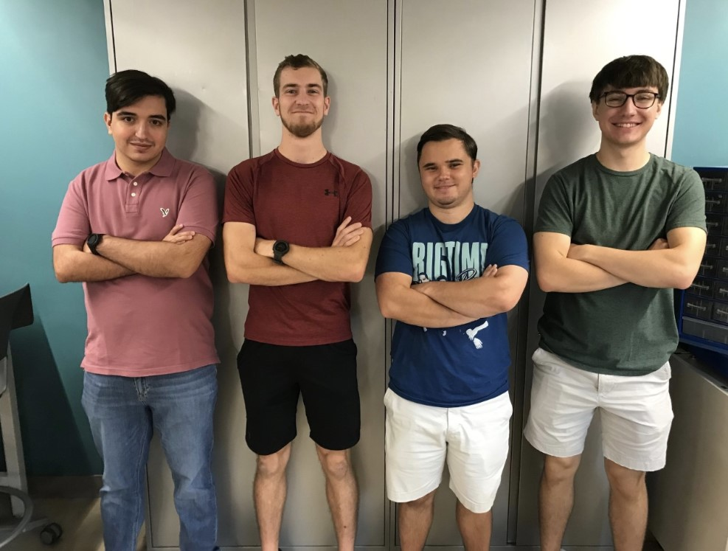
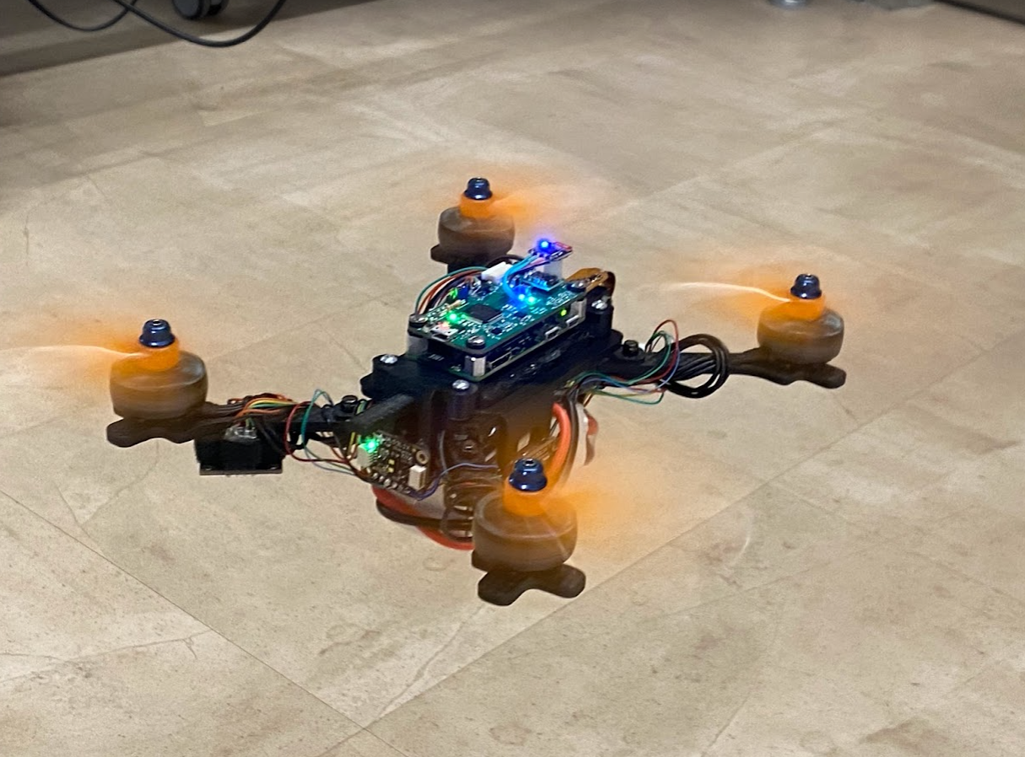
ECE 477 Final Review: Team #8

Slide 2
Outline
Project Overview
Block Diagram
Design Challenges
Individual Contributions
Project Video Demonstration
Questions

Slide 3
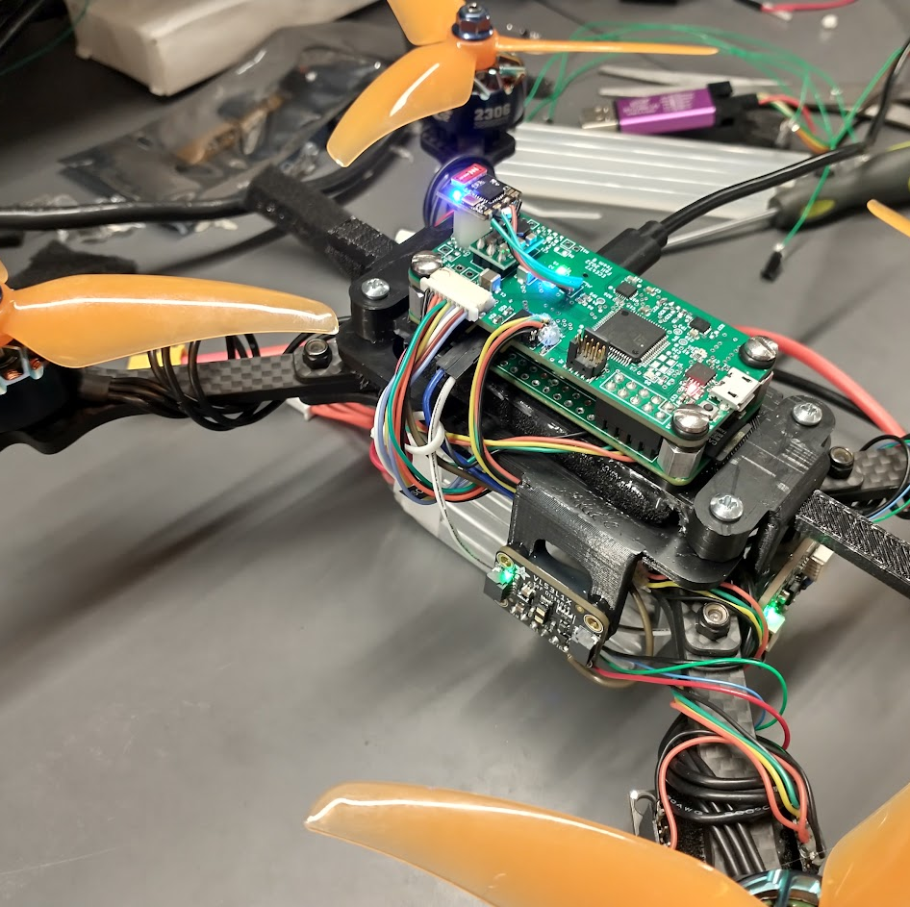
Project Overview
Hermes is an autonomous quadcopter drone
Intended for remote emergency response/search and rescue operations, in a tight confined space.
The drone utilizes a custom flight controller for aerodynamic stability
The navigation computer finds a visual target and sends flight commands to the flight controller.
Intended for remote emergency response/search and rescue operations, in tight confined space.

Slide 4
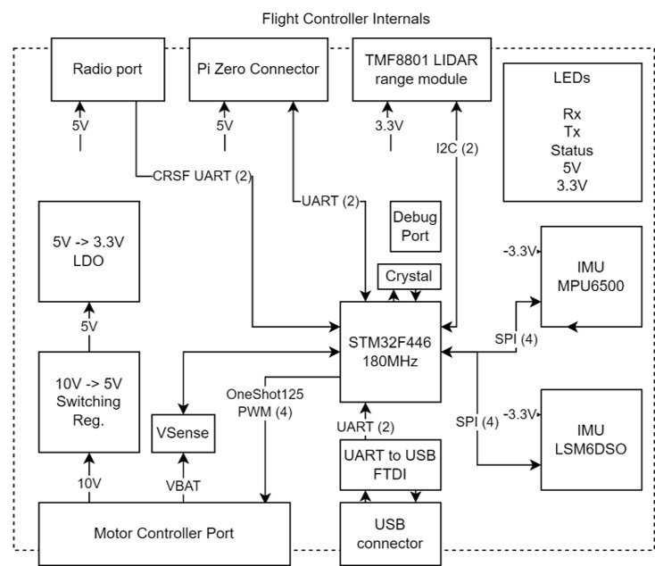
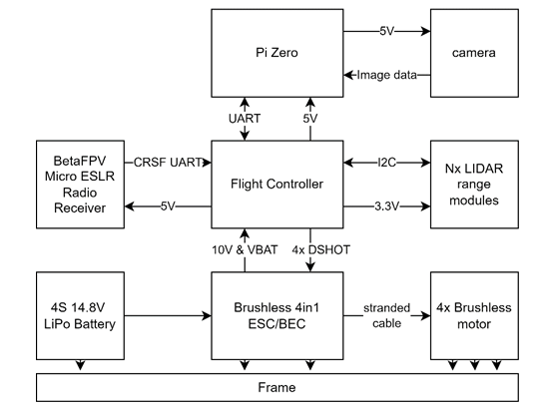
Hardware Block Diagram

Slide 5
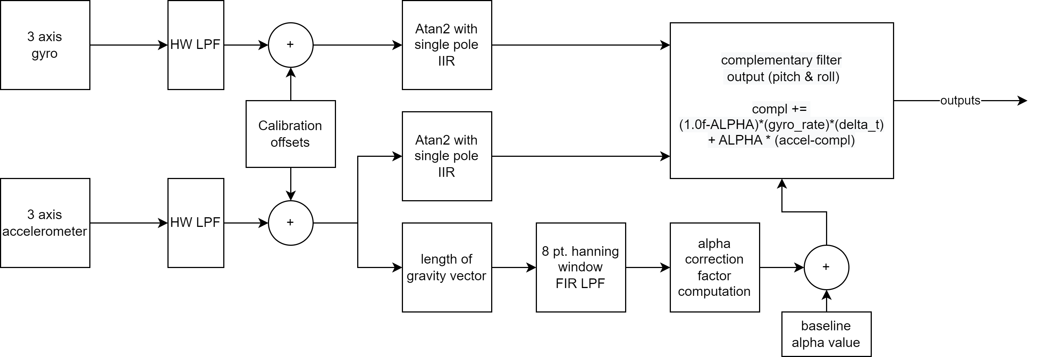
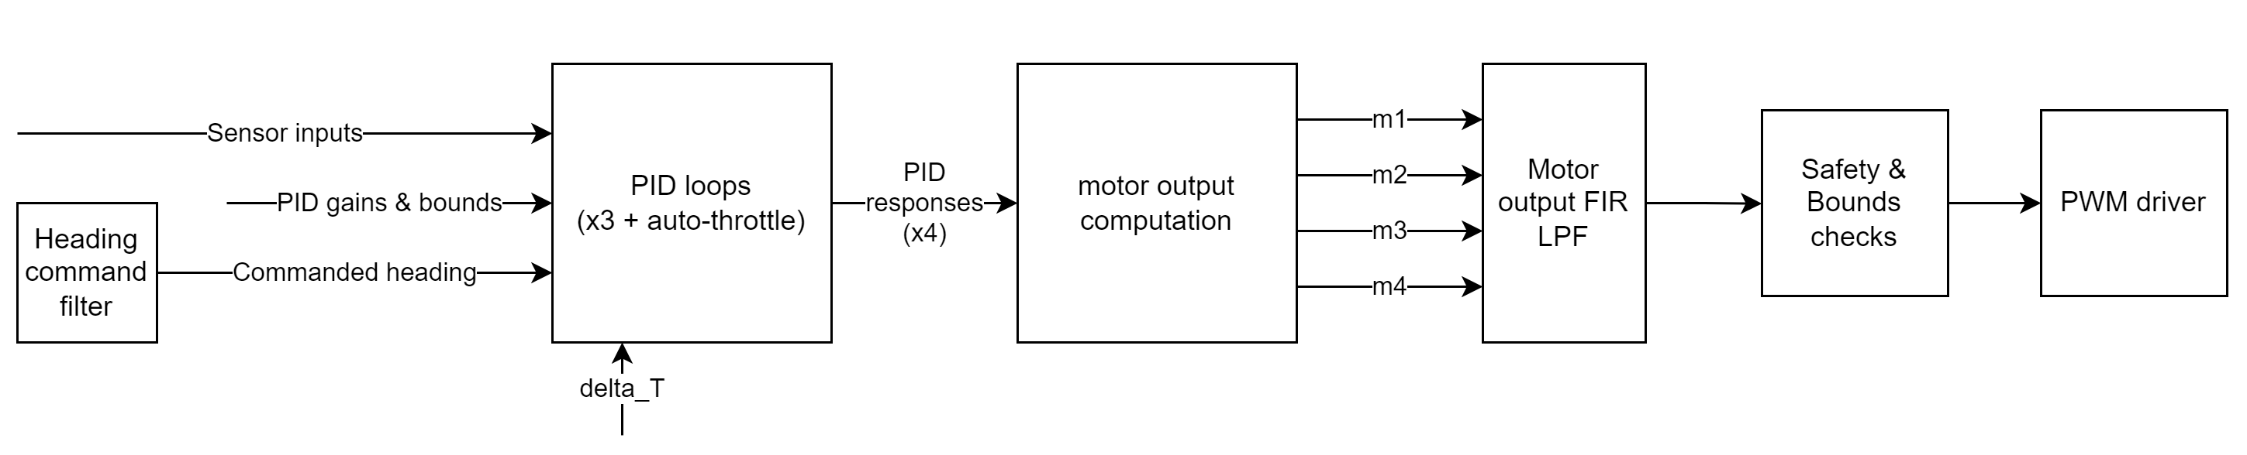
Software Block Diagram
IMU sensor filtering and fusion
Complementary filter with automatically tuned gyro vs. accelerometer trust parameter
Control loop configuration and filtering
4x PID loops for yaw, pitch, roll, and auto-throttle (maintain set height)

Slide 6
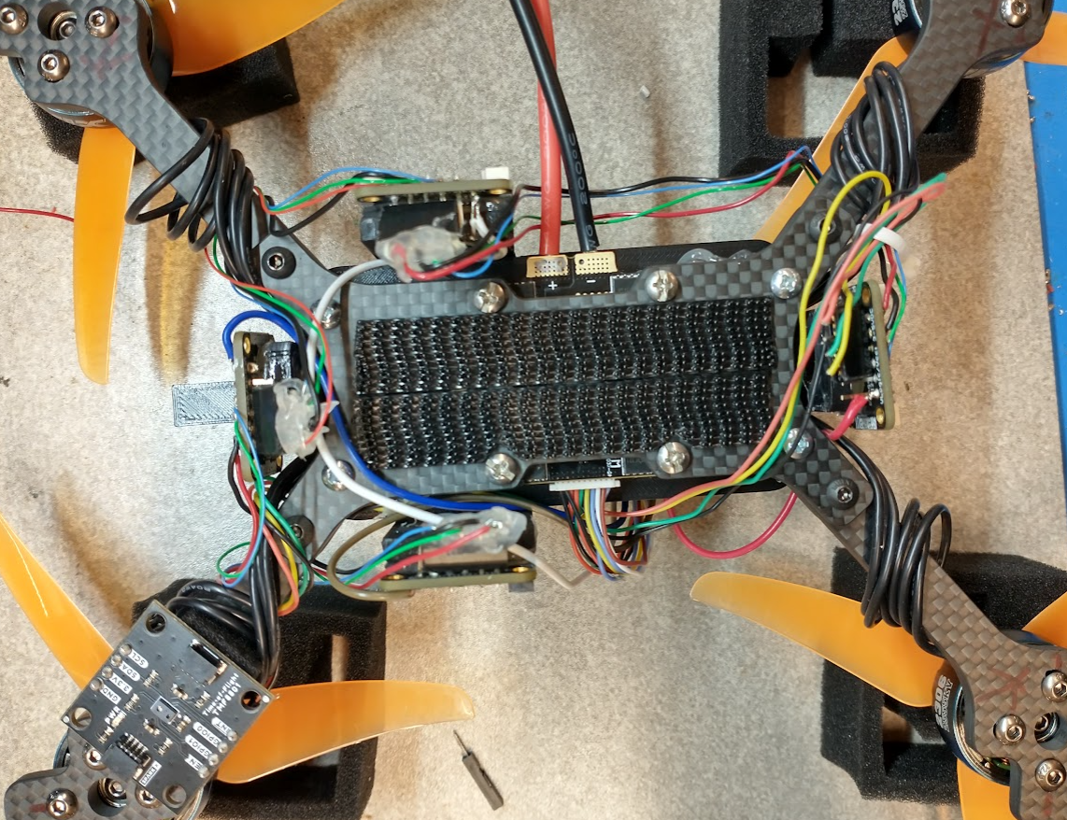
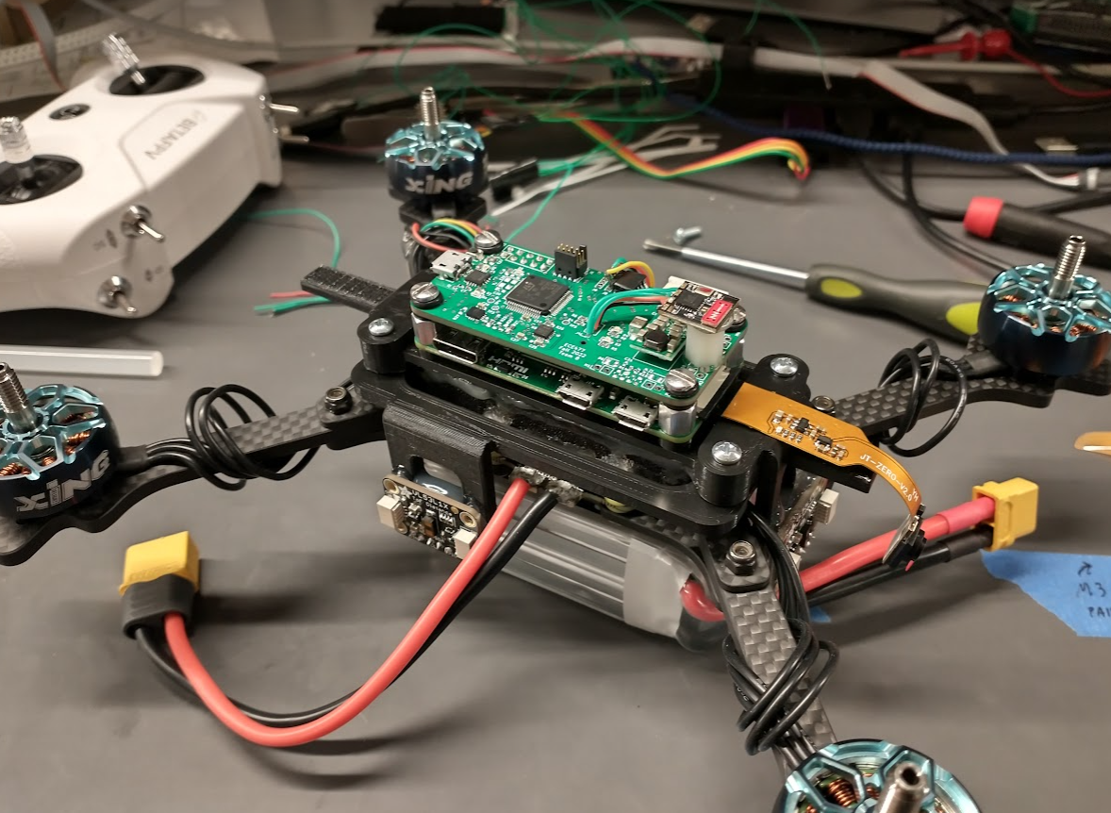
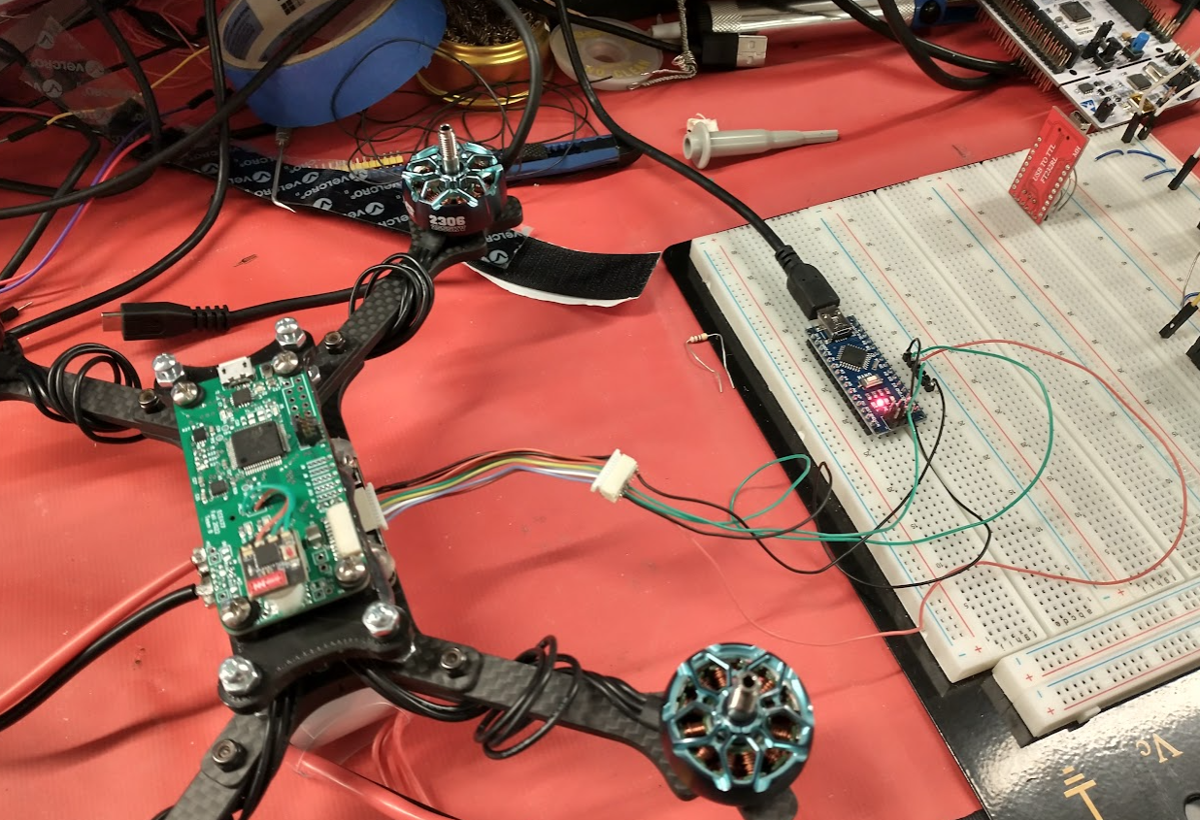
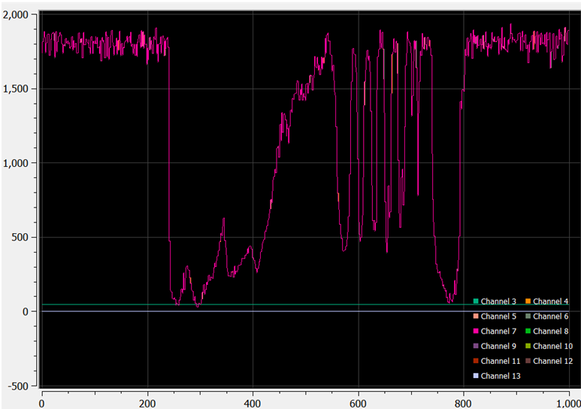
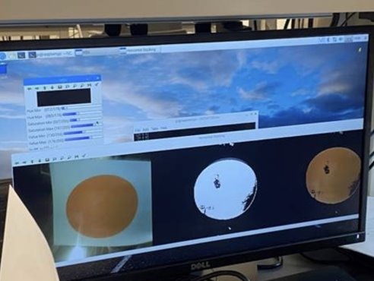
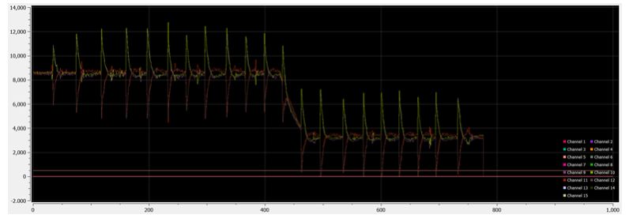
Design Challenges
BLHeli Configurator
Navigation code minimization
Optimizing layout of all the components in our final packaging
Creating the wiring harness for the VL53L1X
I2C bus for the Pi Zero
Signal Processing and control loops

Slide 7
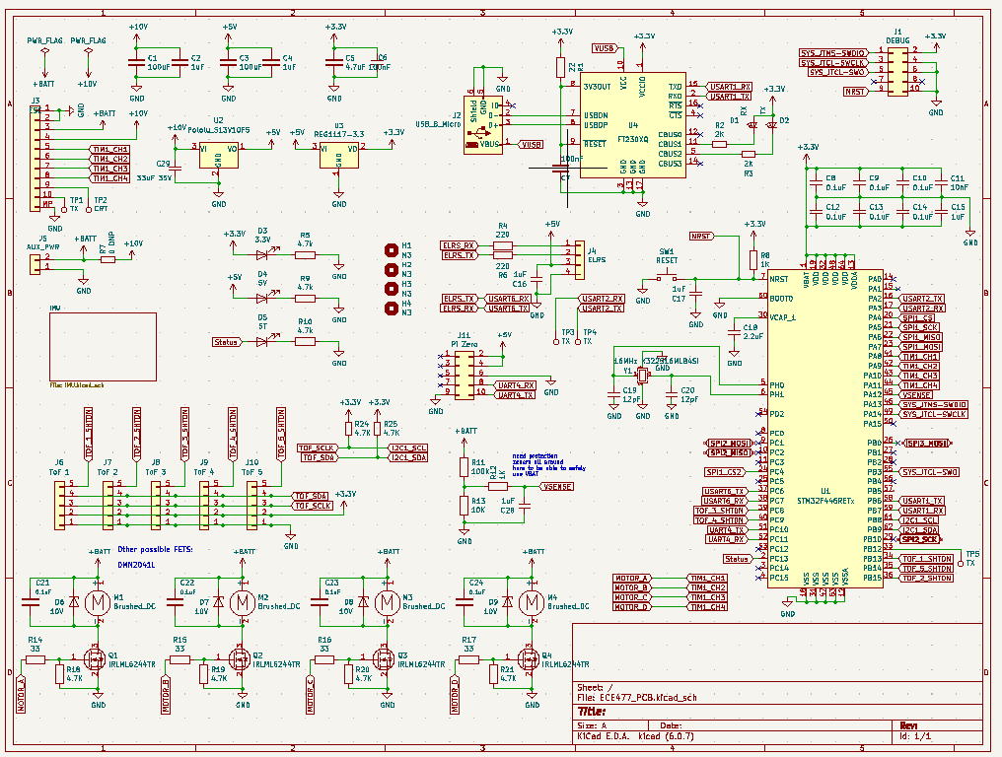
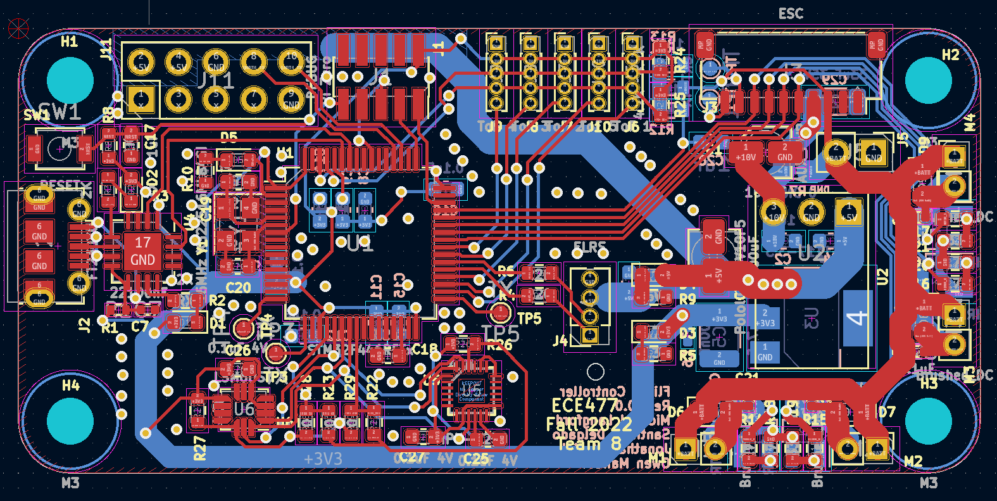
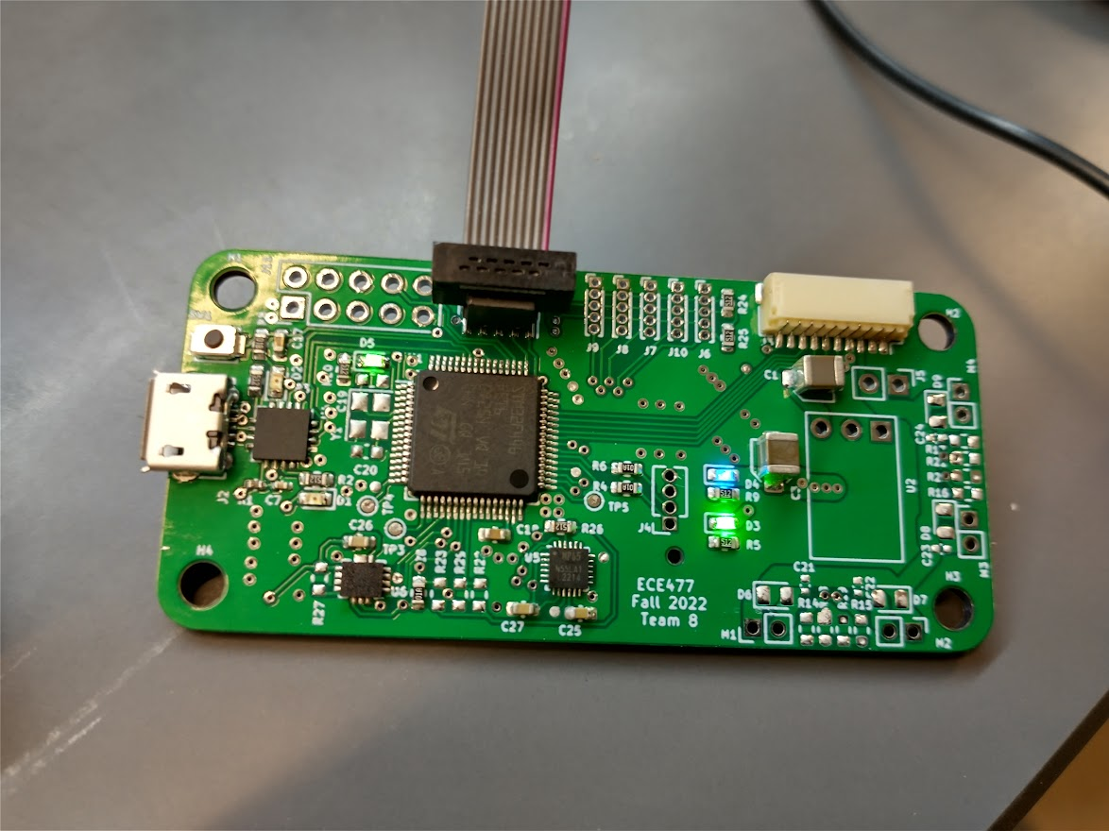
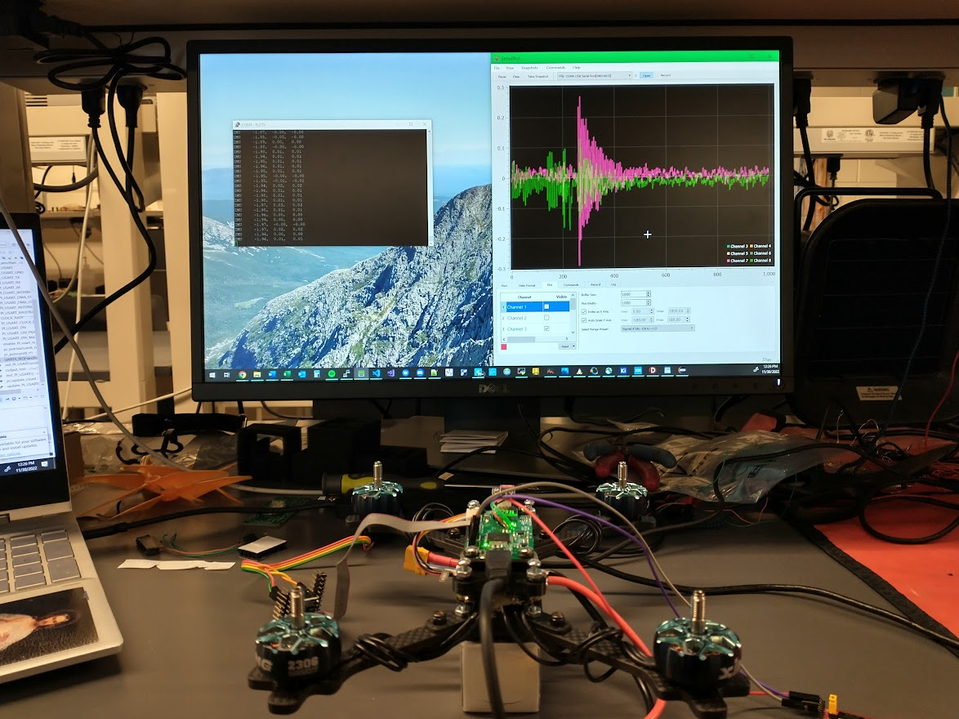
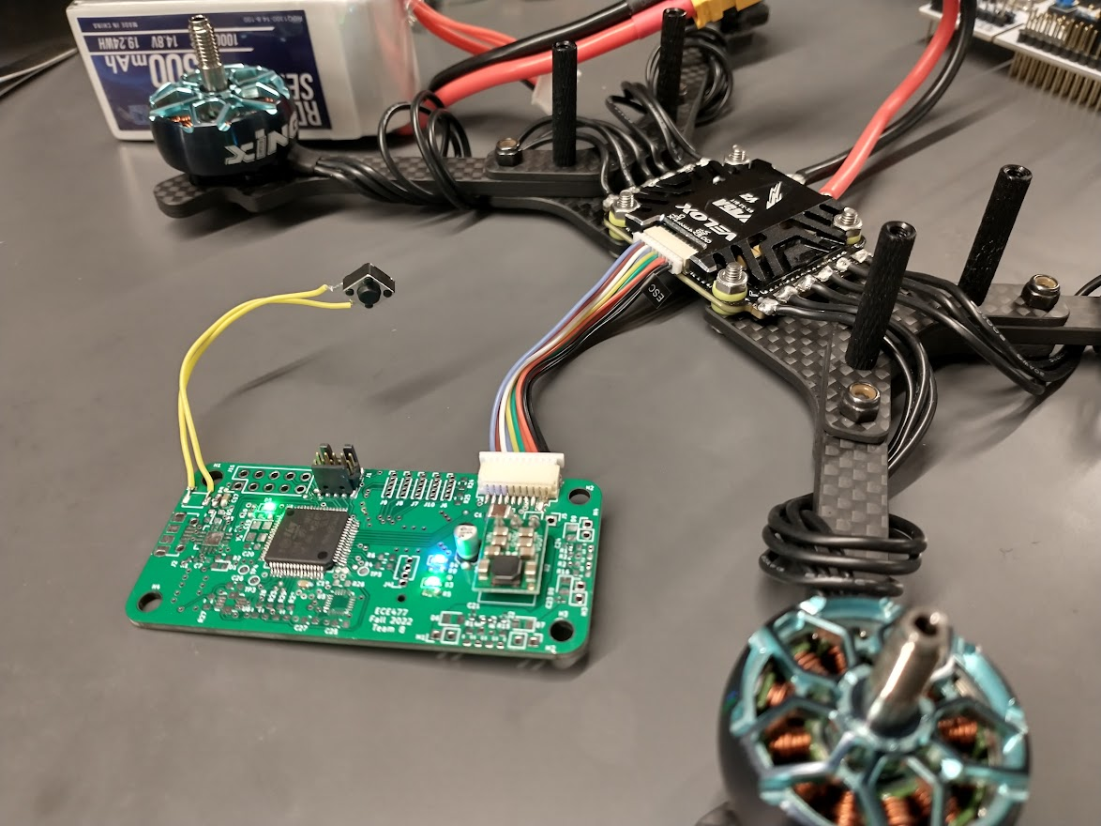
Individual contributions
Michael Langford
System level design, Component selection
Schematic & PCB Design & Assembly of Flight Controller
Embedded SW for Flight controller
IMU driver, signal processing, stability & auto-throttle control loops
Sensor fusion, PID loops, IIR & FIR filtering
UART, radio RX, ONEShot125, BLHeli32 configuration, safety, clock, & timing
Frame & Motor assembly, Soldering of PCB and motors etc.

Slide 8
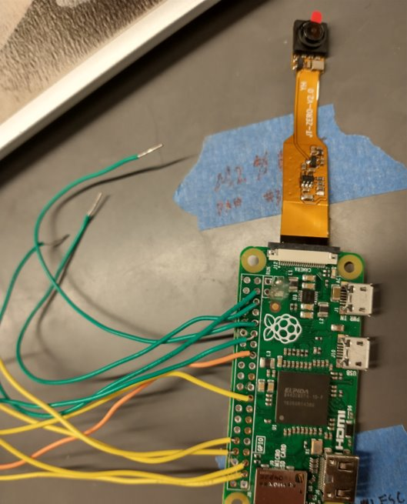
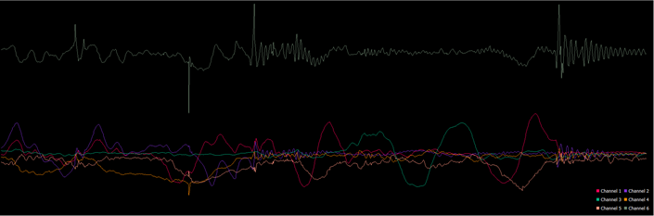
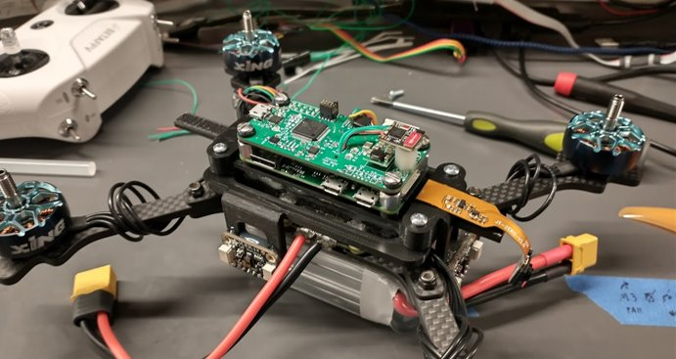
Individual contributions
Owen Mandel
Worked on implementing the SPI code for the gyroscope and accelerometer
Implemented the VL53L1X LiDARs on the Pi Zero
Created the navigation code
Implemented the object detection code with the navigation code
Added the Pi UART communication bus to the flight controller

Slide 9
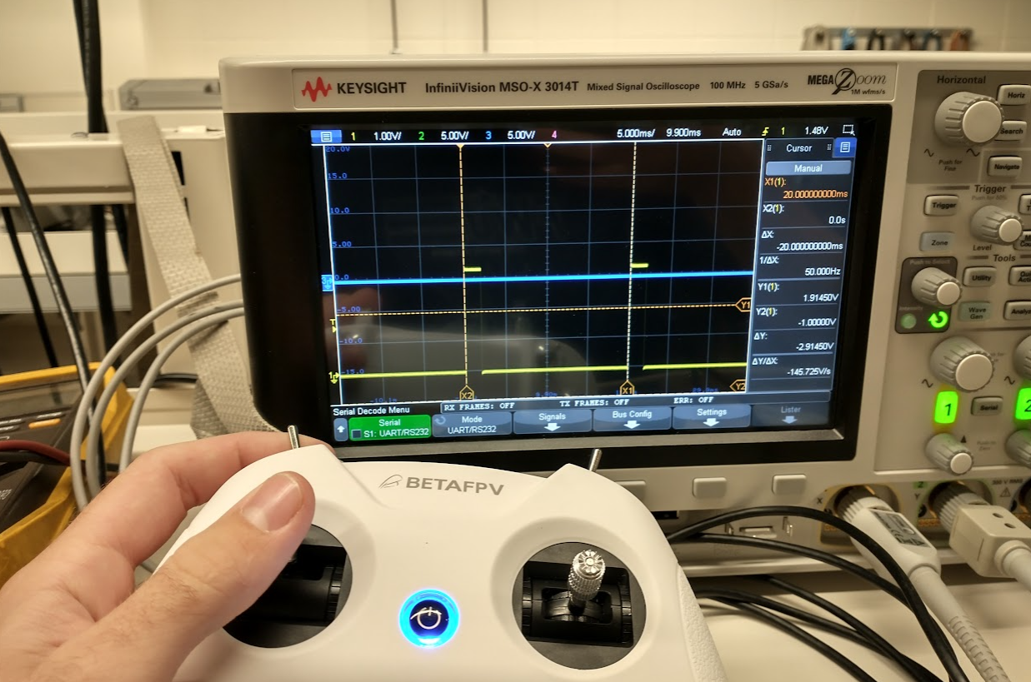
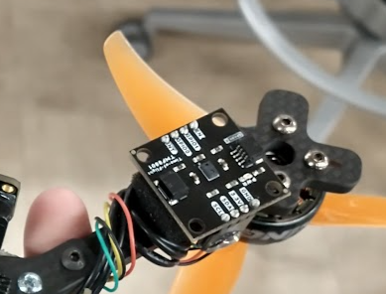
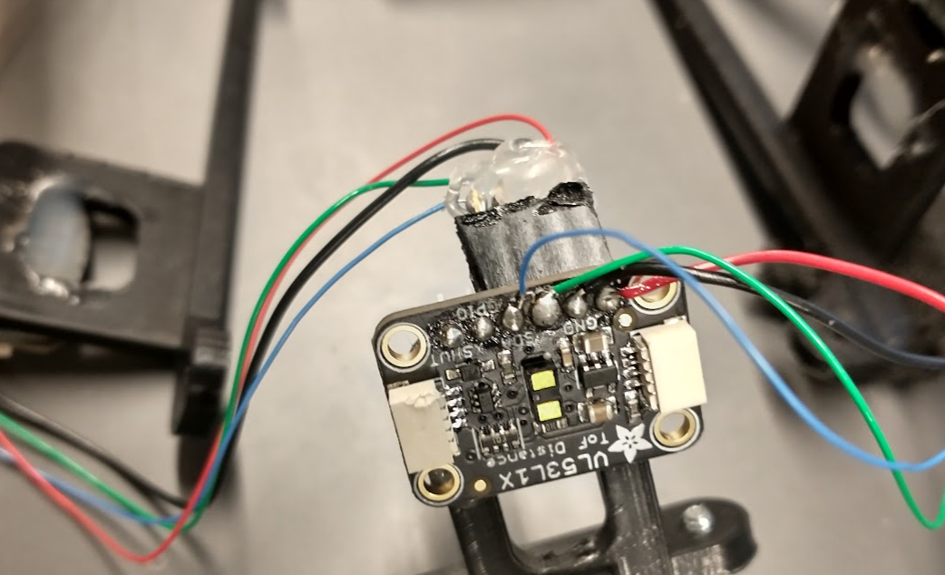
Individual contributions
Santiago J. Garcia Delgado
Worked on making the PWM code to communicate with the ESC.
Translated Sparkfun Arduino TMF8801 library to work on our STM32F446 microcontroller.
Assisted in building wiring harness for TOF sensors.

Slide 10
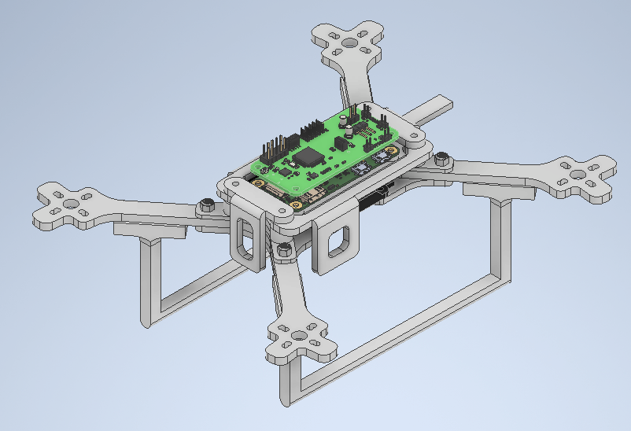
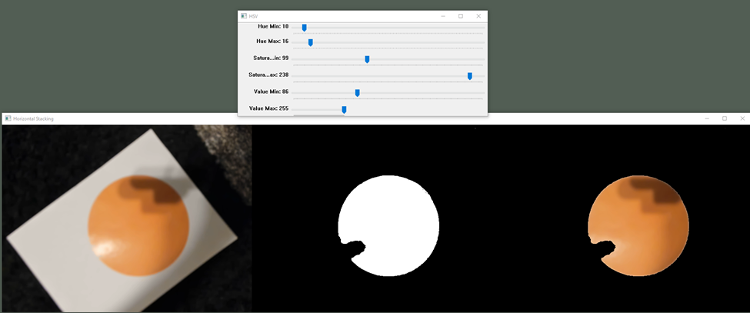
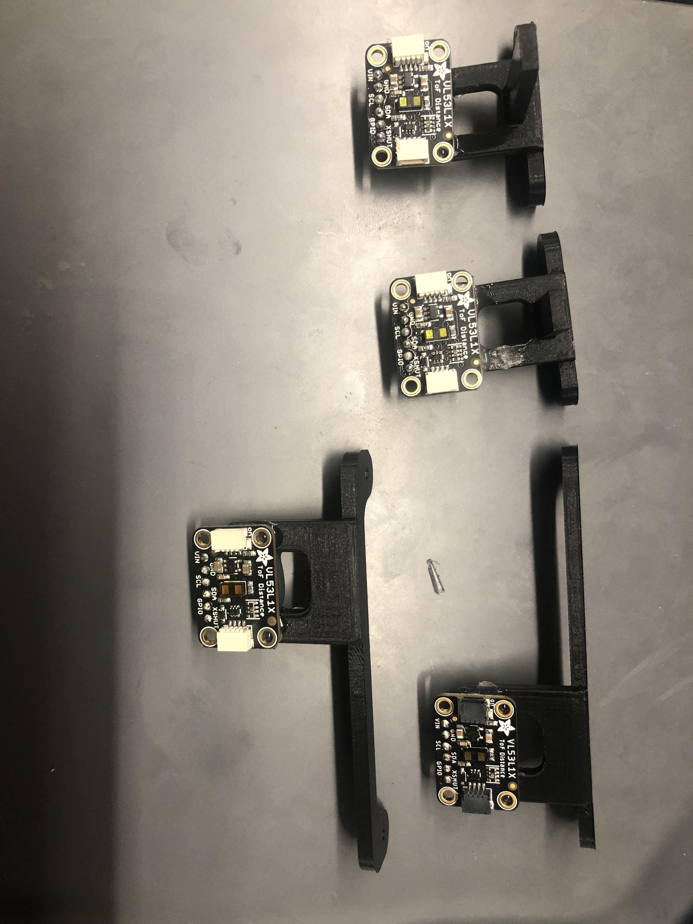
Individual contributions
Jonathan Wosiak
Object detection using OpenCV
3D Printing and modeling
LiDAR / ToF selection and I2C work for VL53L1X

Slide 11
Project Demonstration
An ability to read controller joystick axis channel values from incoming signal from off the shelf radio receiver (via CRSF)
An ability to send and receive navigation command and IMU sensor data between an onboard single-based computer and flight controller microcontroller (via UART)
An ability to send signals to a motor controller and control speed of all 4 motors simultaneously (via PWM)
An ability to communicate with and real sensor data off a gyroscope & accelerometer (via SPI)
An ability to measure distance from walls or floor from time-of-flight proximity sensor (via I2C)

Slide 12
https://www.youtube.com/watch?v=MRFakSWxx5s

Slide 13
Questions?

